Slide 1
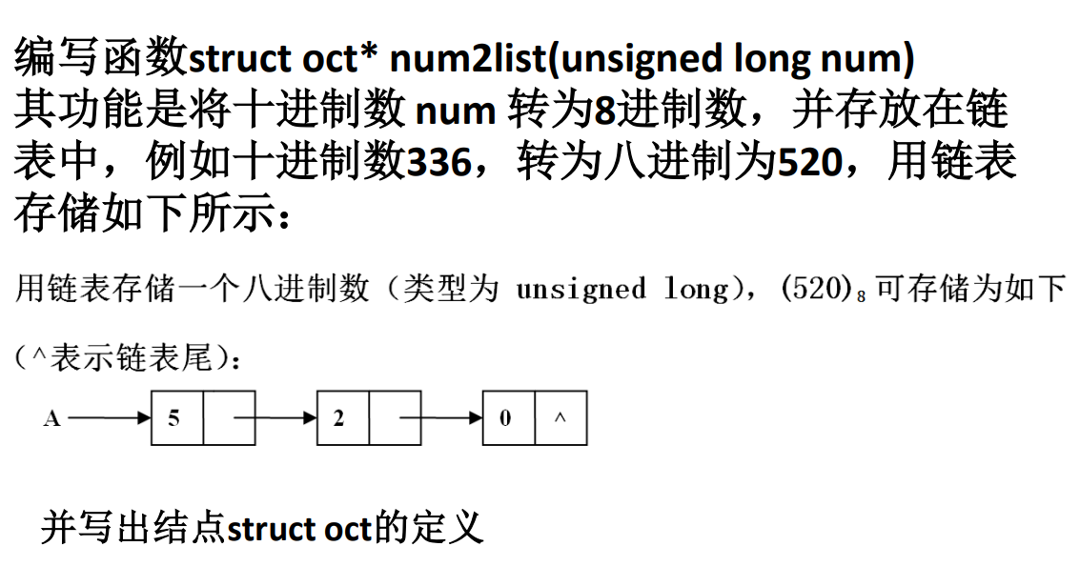

Slide 2
struct oct* num2list(unsigned long num)
{
struct oct* head = NULL;
struct oct* node = NULL;
int i;
while (num != 0) //创建链表
{
i = num % 8;
num /= 8;
node = (struct oct*)malloc(sizeof(struct oct)); //创建结点
node->d = i;
node->next = head; //头插法
head = node;
}
return head;
}

